Slide 1


Adeeb Naiyer
10/06/2025

Slide 2
Outline
Executive Summary
Introduction
Methodology
Results
Conclusion
Appendix
2

Slide 3
Executive Summary
Summary of methodologies
Data collection
Data wrangling
EDA with data visualization
EDA with SQL
Building an interactive map with Folium
Building a Dashboard with Plotly Dash
Predictive analysis (Classification)
Summary of all results
EDA results
Interactive analytics
Predictive analysis
3

Slide 4
Introduction
Project background and context
SpaceX advertises Falcon 9 rocket launches on its website, with a cost of 62 million dollars; other providers cost upward of 165 million dollars each, much of the savings is because SpaceX can reuse the first stage.
Problems you want to find answers
The project task is to predicting if the first stage of the SpaceX Falcon 9 rocket will land successfully
4

Slide 5

5

Slide 6
Methodology
Executive Summary
Data collection methodology:
SpaceX Rest API
Web Scrapping from Wikipedia
Perform data wrangling
One Hot Encoding data fields for Machine Learning and data cleaning of null values and irrelevant columns
Perform exploratory data analysis (EDA) using visualization and SQL
Perform interactive visual analytics using Folium and Plotly Dash
Perform predictive analysis using classification models
LR, KNN, SVM, DT models have been built and evaluated for the best classifier

Slide 7
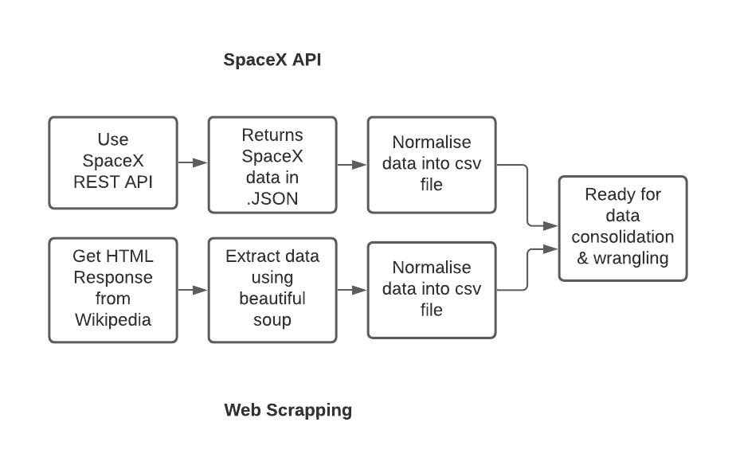
Data Collection
The following datasets was collected:
SpaceX launch data that is gathered from the SpaceX REST API.
This API will give us data about launches, including information about the rocket used, payload delivered, launch specifications, landing specifications, and landing outcome.
The SpaceX REST API endpoints, or URL, starts with api.spacexdata.com/v4/.
Another popular data source for obtaining Falcon 9 Launch data is web scraping Wikipedia using BeautifulSoup.

Slide 8
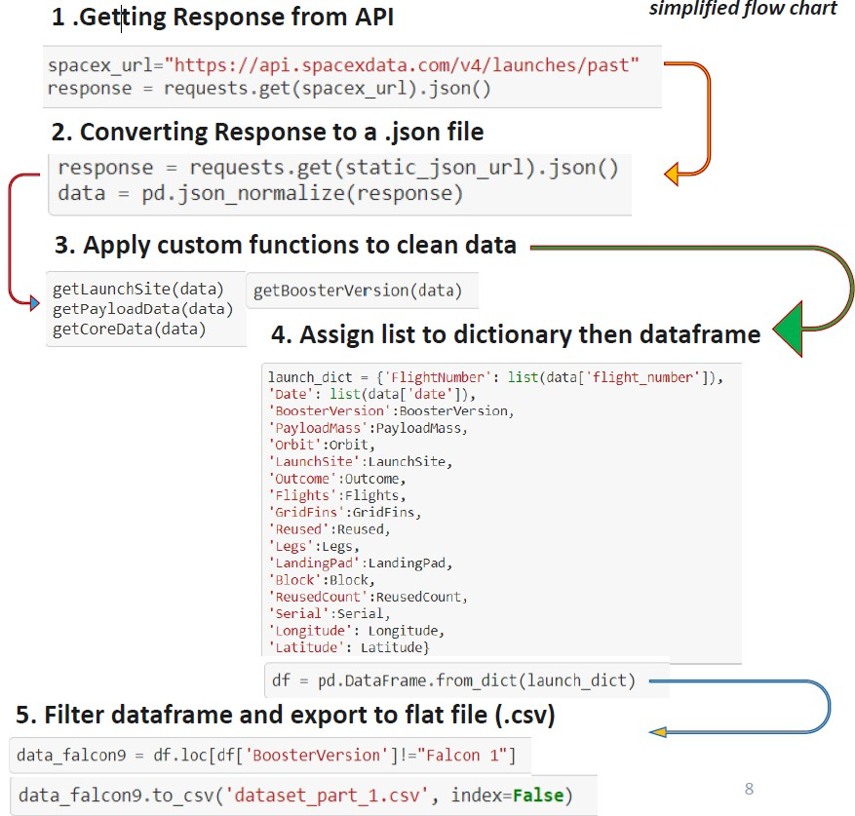
Data Collection – SpaceX API
Data collection with SpaceX REST calls
https://github.com/adeeb1562/Spacex/blob/main/jupyter-labs-spacex-data-collection-api.ipynb

Slide 9
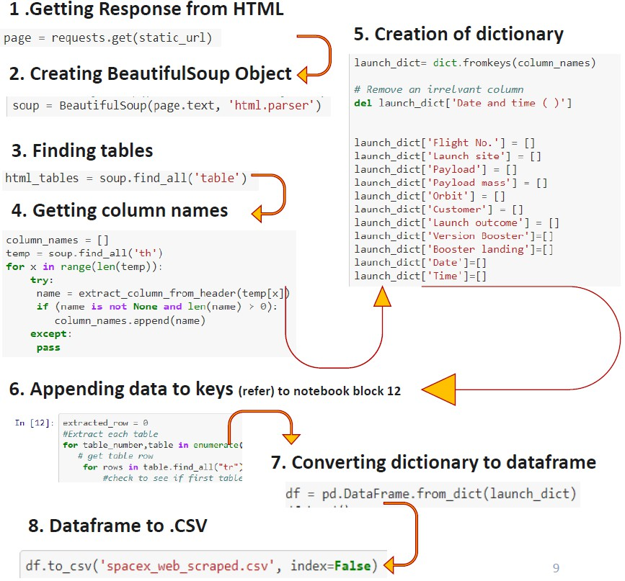
Data Collection - Scraping
Web Scrapping from Wikipedia
Place your flowchart of web scraping here
https://github.com/adeeb1562/Spacex/blob/main/spacex-webscraping.ipynb

Slide 10
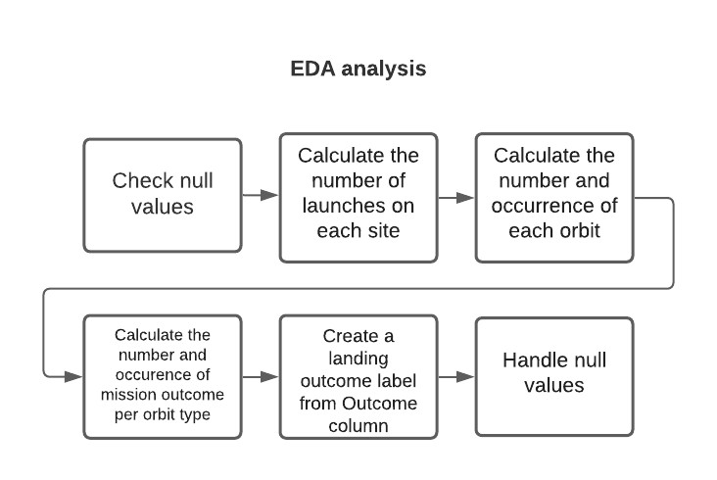
Data Wrangling
https://github.com/adeeb1562/Spacex/blob/main/jupyter-labs-eda-sql.ipynb

Slide 11
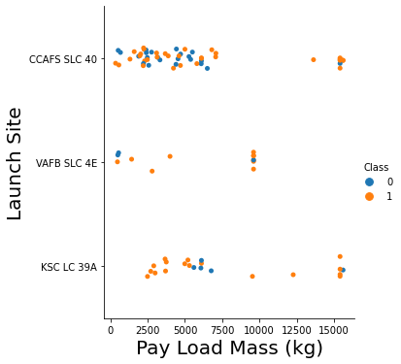
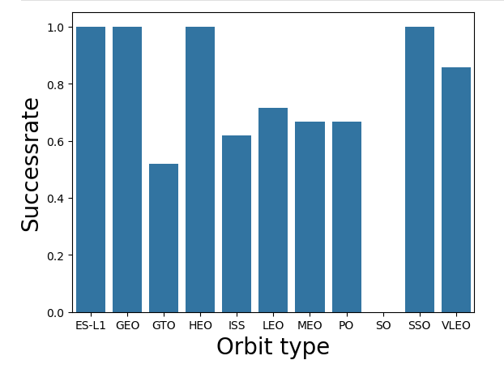
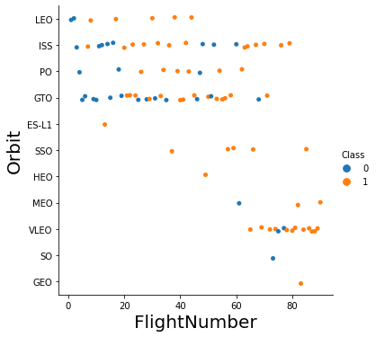
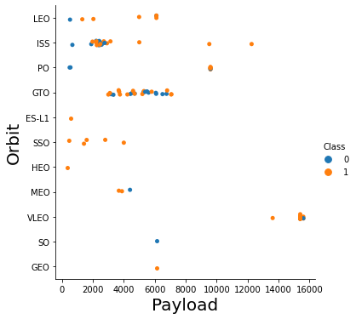
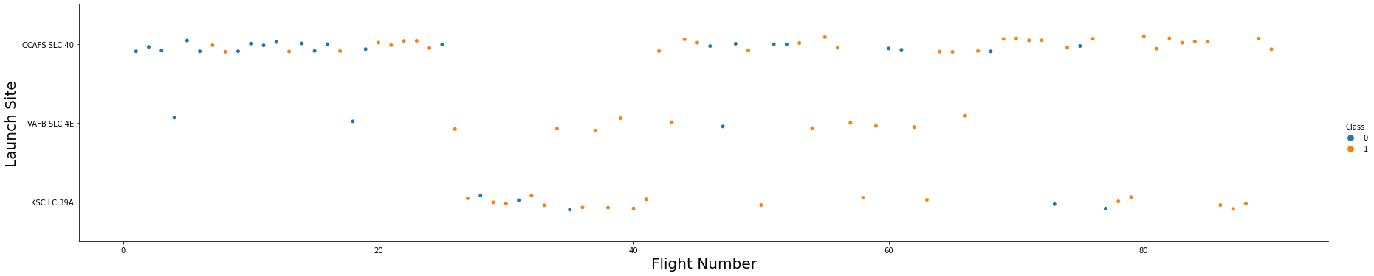
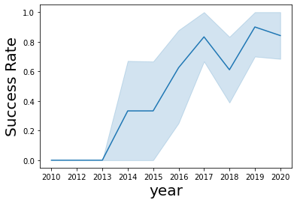
EDA with Data Visualisation
11
https://github.com/adeeb1562/Spacex/blob/main/edadataviz.ipynb

Slide 12
EDA with SQL
SQL queries performed include:
Displaying the names of the unique launch sites in the space mission
Displaying 5 records where launch sites begin with the string 'KSC’
Displaying the total payload mass carried by boosters launched by NASA (CRS)
Displaying average payload mass carried by booster version F9 v1.1
Listing the date where the successful landing outcome in drone ship was achieved.
Listing the names of the boosters which have success in ground pad and have payload mass greater than 4000 but less than 6000
Listing the total number of successful and failure mission outcomes
Listing the names of the booster_versions which have carried the maximum payload mass.
Listing the records which will display the month names, successful landing_outcomes in ground pad ,booster
versions, launch_site for the months in year 2017
Ranking the count of successful landing_outcomes between the date 2010 06 04 and 2017 03 20 in descendingorder.
https://github.com/adeeb1562/Spacex/blob/main/jupyter-labs-eda-sql.ipynb
12

Slide 13
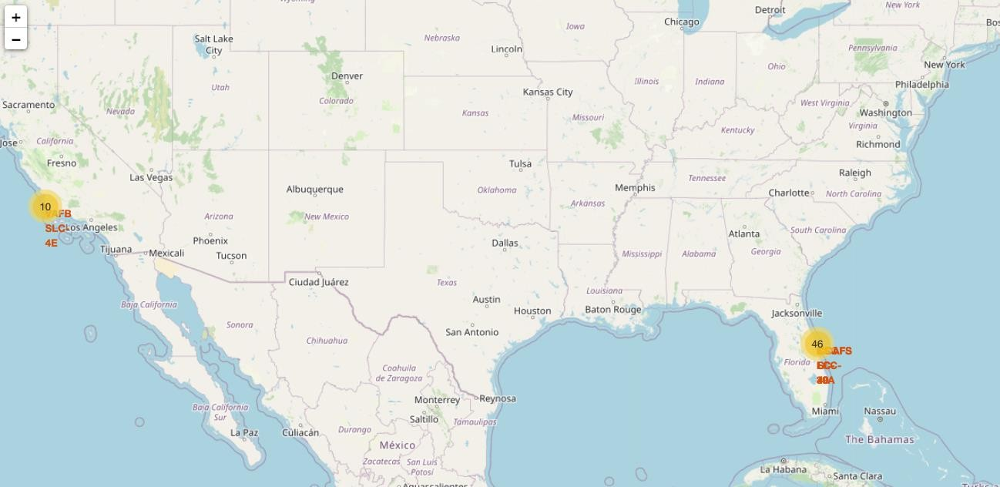
Build an Interactive Map with Folium
Map markers have been added to the map with aim to finding an optimal location for building a launch site
https://github.com/adeeb1562/Spacex/blob/main/lab_jupyter_launch_site_location.ipynb
13

Slide 14
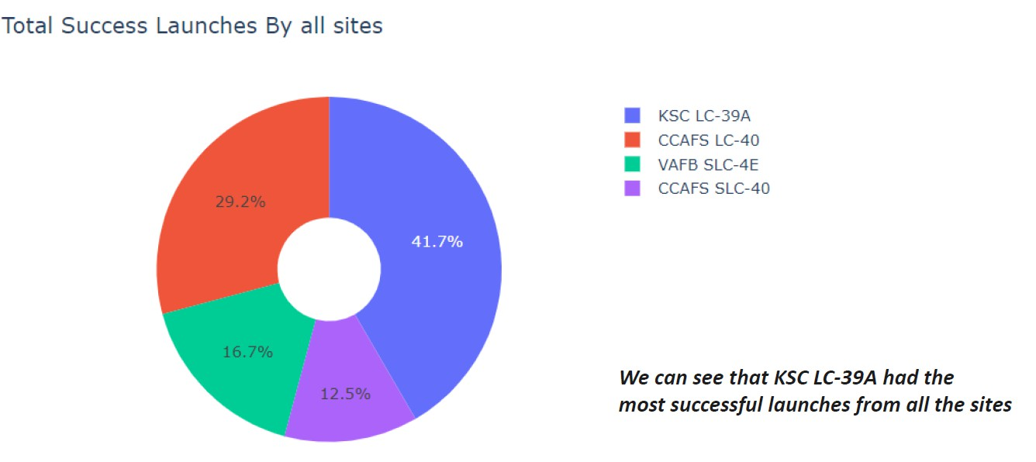
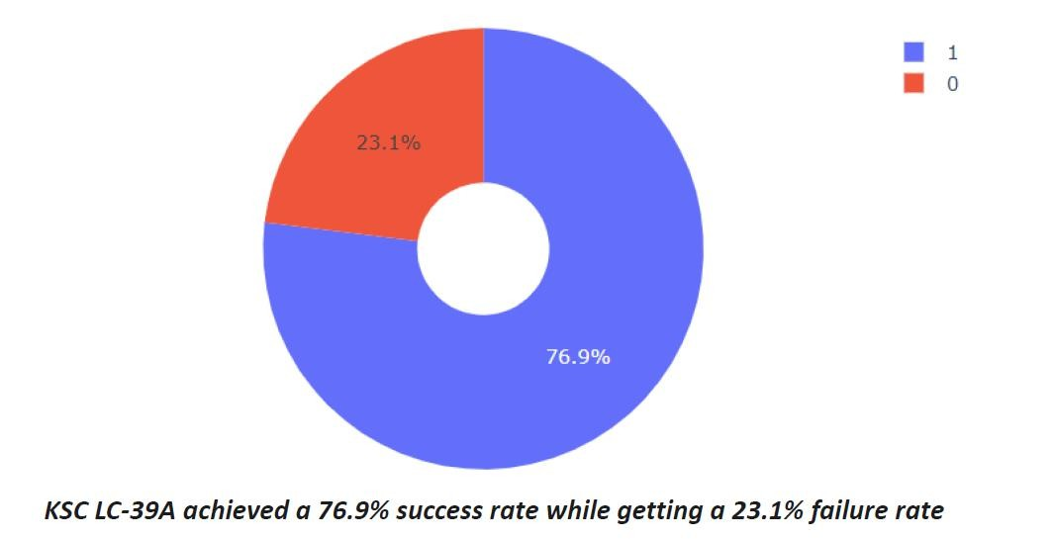
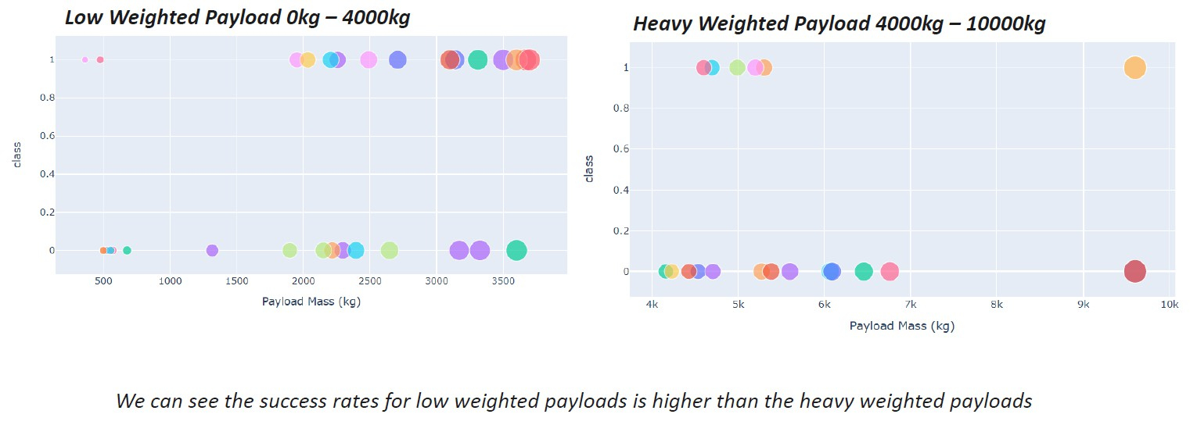
Build a Dashboard with Plotly Dash
14
https://github.com/adeeb1562/Spacex/blob/main/spacex-dash-app%20(1).py

Slide 15
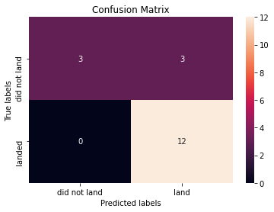
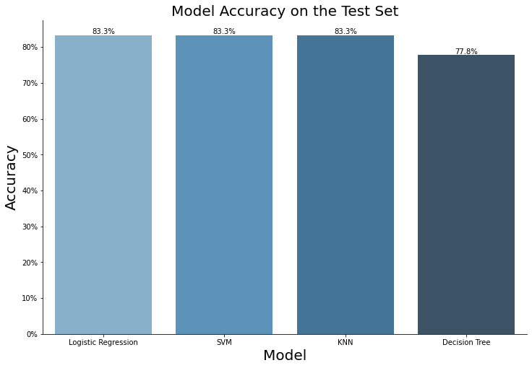
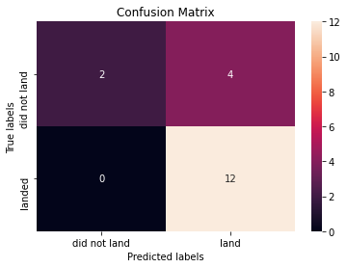
Predictive Analysis (Classification)
The SVM, KNN, and Logistic Regression model achieved the highest accuracy at 83.3%, while the SVM performs the best in terms of Area Under the Curve at 0.958.
https://github.com/adeeb1562/Spacex/blob/main/SpaceX_Machine%20Learning%20Prediction_Part_5.ipynb

Slide 16
Results
The SVM, KNN, DT and Logistic Regression models are the best in terms of prediction accuracy for this dataset.
Low weighted payloads perform better than the heavier payloads.
The success rates for SpaceX launches is directly proportional time in years they will eventually perfect the launches.
KSC LC 39A had the most successful launches from all the sites.
Orbit GEO,HEO,SSO,ES L1 has the best Success Rate.

Slide 17


Slide 18
Flight Number vs. Launch Site
Launches from the site of CCAFS SLC 40 are significantly higher than
launches form other sites.

Slide 19
Payload vs. Launch Site
The majority of lPay Loads with lower Mass have been launched from CCAFS SLC 40.

Slide 20
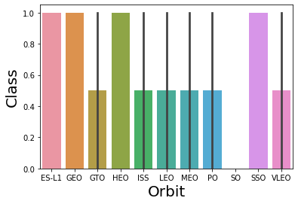
Success Rate vs. Orbit Type
The orbit types of ES-L1, GEO, HEO, SSO are among the highest success rate.

Slide 21
Flight Number vs. Orbit Type
A trend can be observed of shifting to VLEO launches in recent years.

Slide 22
Payload vs. Orbit Type
There are strong correlation between ISS and Payload at the range around 2000, as well as between GTO and the range of 4000-8000.

Slide 23
Launch Success Yearly Trend
Launch success rate has increased significantly since 2013 and has stablised since 2019, potentially due to advance in technology and lessons learned.

Slide 24
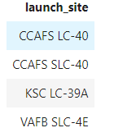
All Launch Site Names
%sql select distinct(LAUNCH_SITE) from SPACEXTBL

Slide 25
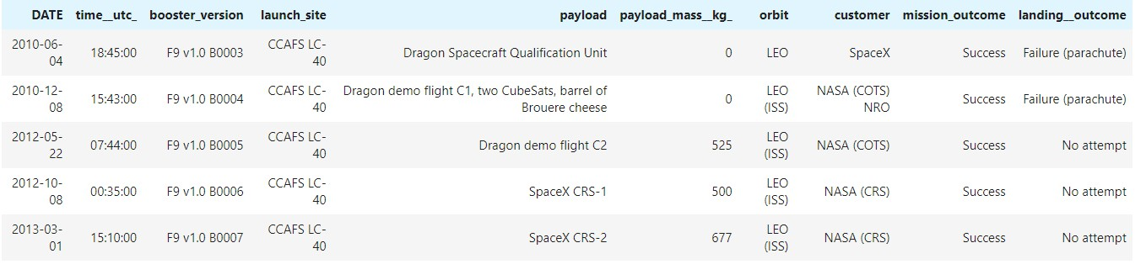
Launch Site Names Begin with 'CCA'
%sql select * from SPACEXTBL where LAUNCH_SITE like 'CCA%' limit 5

Slide 26
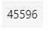
Total Payload Mass
%sql select sum(PAYLOAD_MASS KG_) from SPACEXTBL where CUSTOMER
= 'NASA (CRS)'

Slide 27
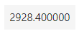
Average Payload Mass by F9 v1.1
%sql select avg(PAYLOAD_MASS KG_) from SPACEXTBL where BOOSTER_VERSION = 'F9 v1.1'

Slide 28
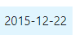
First Successful Ground Landing Date
%sql select min(DATE) from SPACEXTBL where Landing Outcome = 'Success (ground pad)'

Slide 29
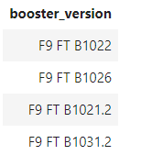
Successful Drone Ship Landing with Payload between 4000 and 6000
%sql select BOOSTER_VERSION from SPACEXTBL where Landing Outcome
= 'Success (drone ship)' and PAYLOAD_MASS KG_ > 4000 and
PAYLOAD_MASS KG_ < 6000

Slide 30
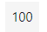
Total Number of Successful and Failure Mission Outcomes
%sql select count(MISSION_OUTCOME) from SPACEXTBL where MISSION_OUTCOME = 'Success' or MISSION_OUTCOME = 'Failure (in flight)'

Slide 31
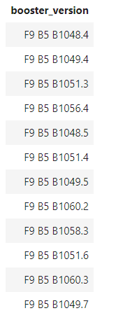
Boosters Carried Maximum Payload
%sql select BOOSTER_VERSION from SPACEXTBL where PAYLOAD_MASS KG_ = (select max(PAYLOAD_MASS KG_) from SPACEXTBL)

Slide 32
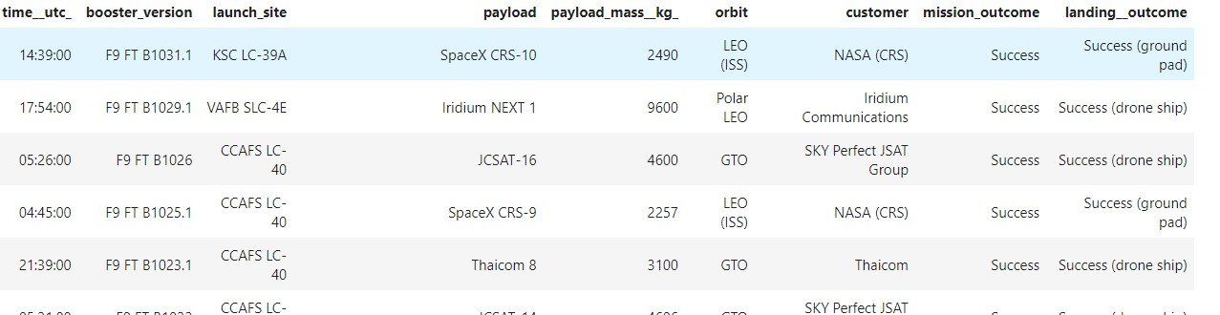
2015 Launch Records
%sql select * from SPACEXTBL where Landing Outcome like 'Success%' and
(DATE between ‘2015-01-01' and ‘2015-12-31') order by date desc

Slide 33
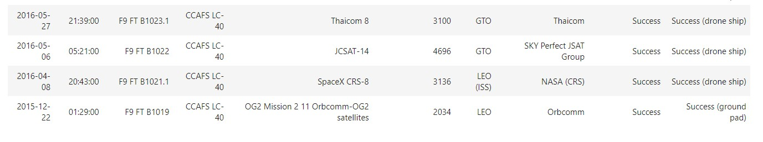
Rank Landing Outcomes Between 2010-06-04 and 2017-03-20
%sql select * from SPACEXTBL where Landing Outcome like 'Success%' and (DATE between '2010-06-04' and '2017-03-20') order by date desc

Slide 34


Slide 35
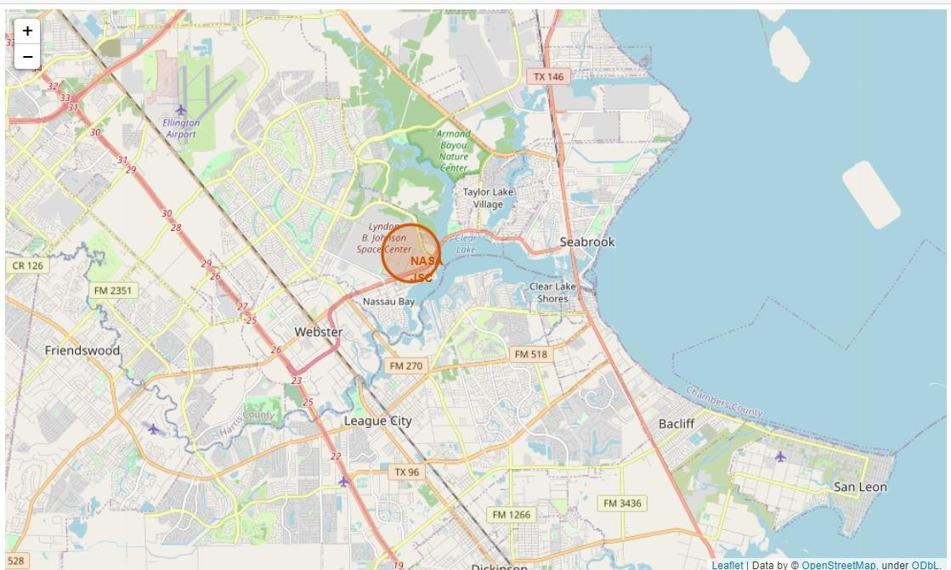
All launch sites marked on a map

Slide 36
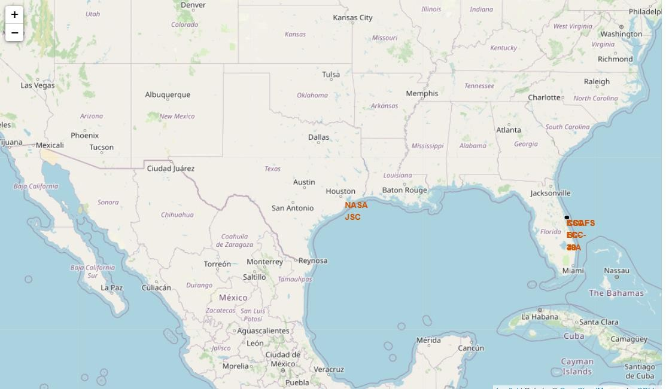
Success/failed launches marked on the map

Slide 37
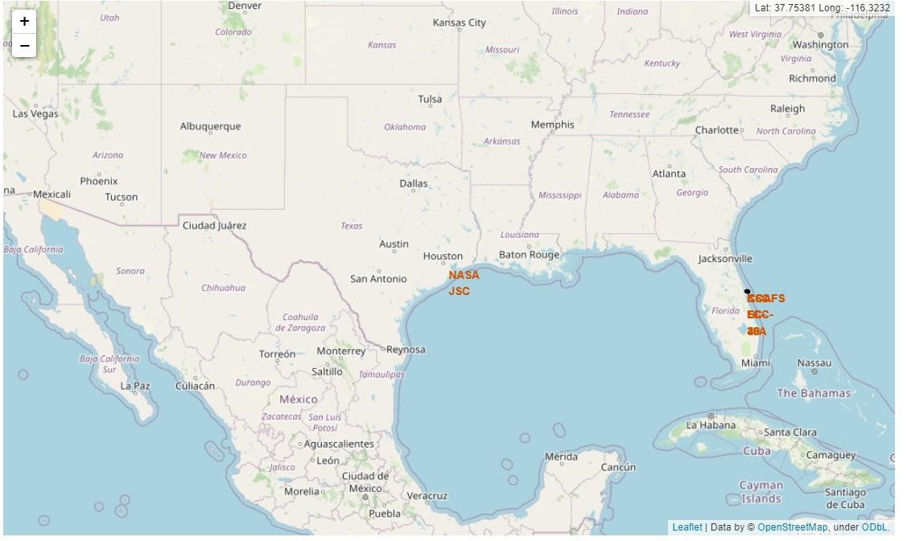
Distances between a launch site to its proximities

Slide 38


Slide 39
Total success launches by all sites

Slide 40
Success rate by site

Slide 41
Payload vs launch outcome

Slide 42


Slide 43
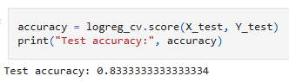
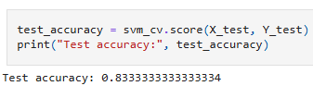
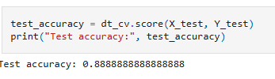
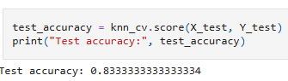
Classification Accuracy
Logistic regression
svm
Decision tree
knn

Slide 44
Confusion Matrix

Slide 45
Conclusions
The DT, SVM, KNN, and Logistic Regression models are the best in terms of
prediction accuracy for this dataset.
Low weighted payloads perform better than the heavier payloads.
The success rates for SpaceX launches is directly proportional time in years they will eventually perfect the launches.
KSC LC 39A had the most successful launches from all the sites.
Orbit GEO,HEO,SSO,ES L1 has the best Success Rate.

Slide 46


